Slide 1
CULTURE
Ways that culture is created, diffused, and enjoyed

Slide 2
CULTURE
Discuss ways that culture can be created. What makes a culture?

Slide 3
CULTURE
DEFINED: The total of knowledge, attitudes, and behaviors shared by, and passed on by the members of a specific group.
Examples include the Native American storytelling ritual (as there is very little history written down, it is passed on by storytelling).
Culture ties us to one group and separates us from another (I belong to a group called sports fans, and we are separate from people who are not sports fans.)

Slide 4
CULTURE
Ethnic groups (share a common language, customs, and heritage) are the most readily noticeable groups in terms of culture. What are some others that you can think of?
Your book references The San Peoples, known as Bushmen of the Kalahari Desert and how they live in a region with other groups, but have distinctions that set them apart.
In the next slide, look at the picture and discuss what you see that might tell you this group has a particular culture.

Slide 5
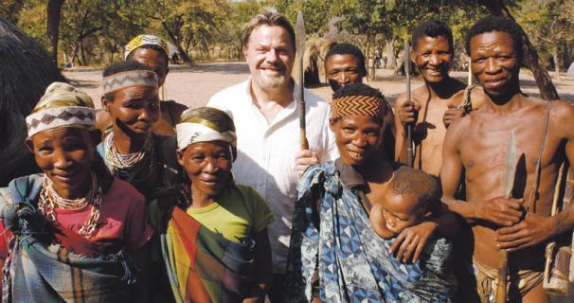
CULTURE

